Slide 1


Slide 2


Slide 3
Angular Fundamentals
Architecture
Template and Data Binding
Forms
Bootstraping
NgModules
Dependency Injection
Http Client
Routing and Navigation
Testing

Slide 4
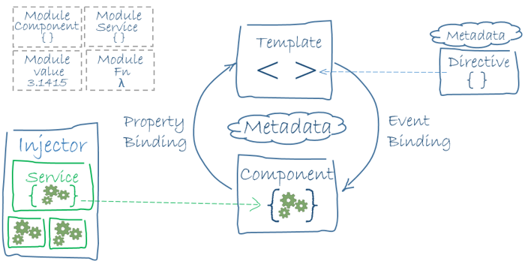
Architecture:

Slide 5
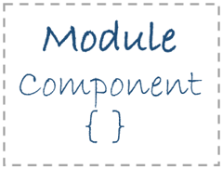
NgModule -Every Angular app has at least one NgModule class, the root module, conventionally named AppModule
Declarations (the view classes that belong to this module. Angular has three kinds of view classes: components, directives, and pipes.)
Components
Directives
Pipes
Exports
Imports
Providers
Bootstrap - the main application view, called the root component, that hosts all other app views. Only the root module should set this bootstrap property.
Component classes should be lean. They don't fetch data from the server, validate user input, or log directly to the console. They delegate such tasks to services.

Slide 6
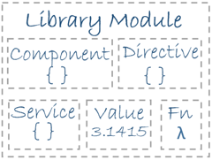
ex:
import { Component } from '@angular/core';
Angular Libraries - (Angular ships as a collection of JavaScript modules. You can think of them as library modules.)

